Slide 1
HMM packages

Slide 2
HMM workflow
These HMMs were run for grayling_46909 from Altusried
Steps in workflow:
Regularize track using the CRAWL package in Rstudio (5 second interval; 172558 obs; 4/4/2018 11:21 to 14/4/2018 11:01)
Break up track into subtracks (resulting in 1001 tracks)
Remove small (< 10 detections) tracks (resulting in 400 tracks; avg 38 obs)
Develop HMMs with different packages
moveHMM → most basic animal movement HMM package. Option to use step length only, not possible to include other datastreams
momentuHMM → extension of moveHMM package with option to include new datastreams. Forced to use turning angle
depmixS4 → Developed for social sciences. Very flexible in datastreams. Difficult to change data distributions. Ran for both steps+angle and step+straightness index

Slide 3
Additional comments on the packages
moveHMM
Great to make a basic HMM. Easy to understand, difficult to expand. Basically limited to using steps or steps+turning angle. No additional data streams possible
momentuHMM
Great to extend a moveHMM model. Package is also written as extension to moveHMM. Now with the possibility to include new datastreams (e.g. straightness index). But long computation times and (for now) has difficulties/is unable to converge when including straightness
depmixS4
Relatively easy to implement and very flexible with regards to datastreams. But changing data distributions seems more difficult.

Slide 4
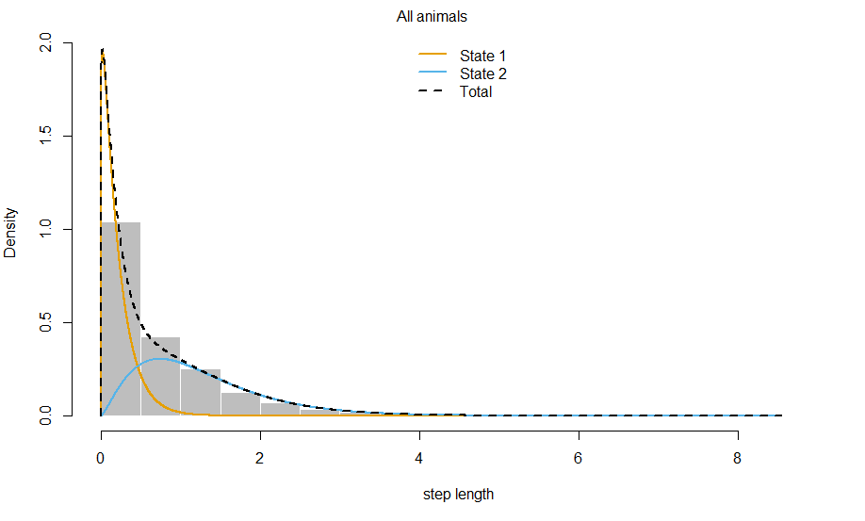
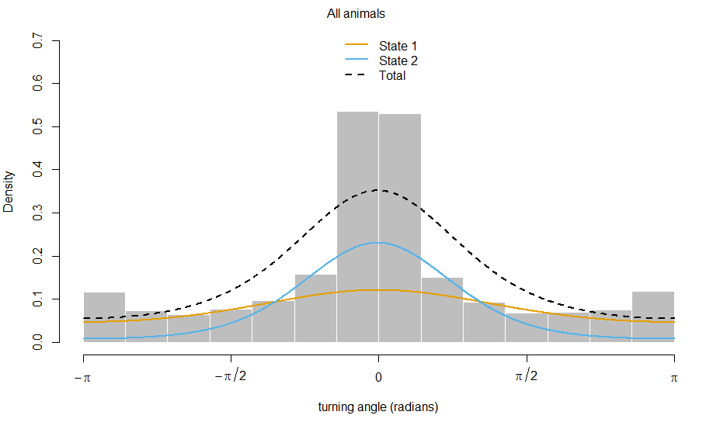
moveHMM
State 1 ➔ Mean: 0.189; st.dev: 0.174
State 2 ➔ Mean: 1.218; st.dev : 0.803
State 1 ➔ Mean: -0.007; conc: 0.474
State 2 ➔ Mean: -0.015; conc: 1.668
MLE: -4602.493
AIC: 9218.987

Slide 5
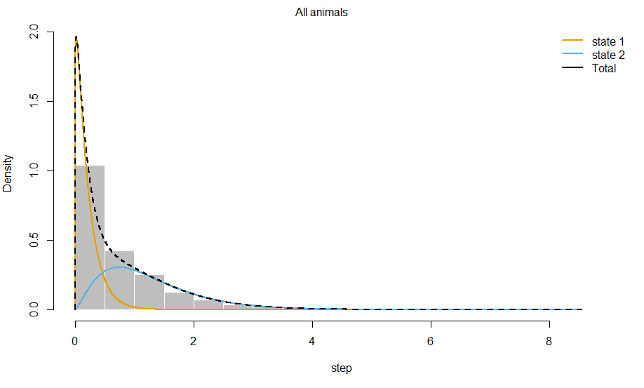
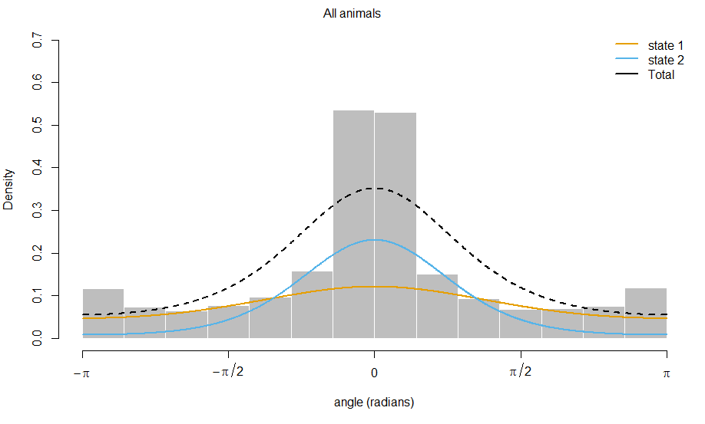
momentuHMM
State 1 ➔ Mean: 0.210; st.dev: 0.199
State 2 ➔ Mean: 1.256; st.dev : 0.806
State 1 ➔ Mean: 0; conc : 0.474
State 2 ➔ Mean: 0; conc : 1.667
MLE: -24159.3
AIC: 48336.6

Slide 6
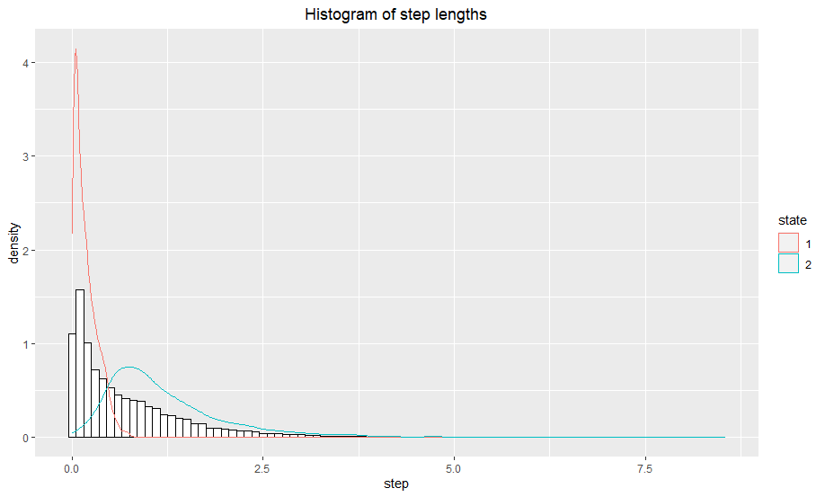
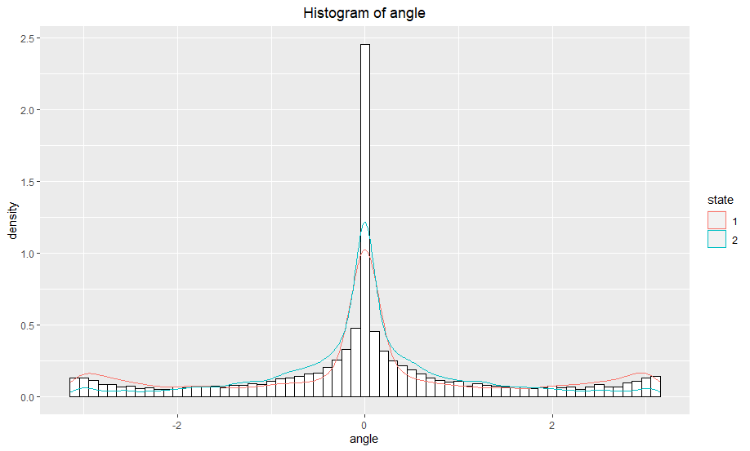
depmixS4 – Steps & Angle
State 1 ➔ Mean: 0.176; st.dev: 0.149
State 2 ➔ Mean: 1.241; st.dev : 0.881
State 1 ➔ Mean: 0.004; st.dev : 1.582
State 2 ➔ Mean: -0.002; st.dev : 1.119
MLE: -8127.15
AIC: 16267.48

Slide 7
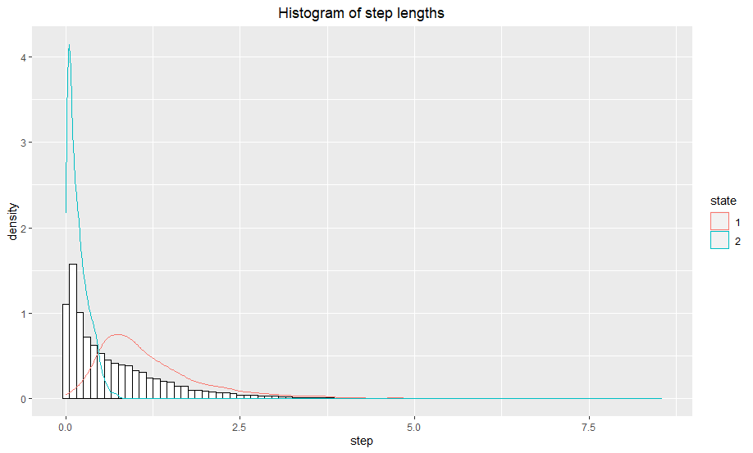
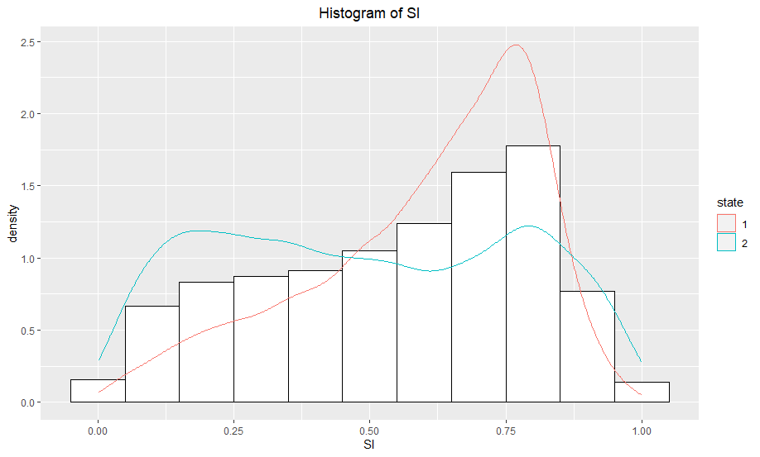
depmixS4 – Steps & Straightness Index (SI)
State 1 ➔ Mean: 1.241; st.dev: 0.881
State 2 ➔ Mean: 0.176; st.dev : 0.149
State 1 ➔ Mean: 0.60; st.dev : 0.211
State 2 ➔ Mean: 0.49; st.dev : 0.274
MLE: -30405.28
AIC: 60832.56

Slide 8
Questions that remain
What causes the differences in MLE and AIC between moveHMM and momentuHMM?
Data is the same, states are the same → So model development remains as source?
How to use different data distributions in depmixS4
Should be possible (according to paper and description)

